Slide 1
Top down,
Bottom up
and transform and conquer approaches to algorithm design

Slide 2
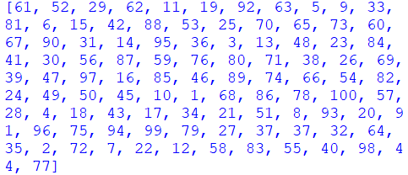
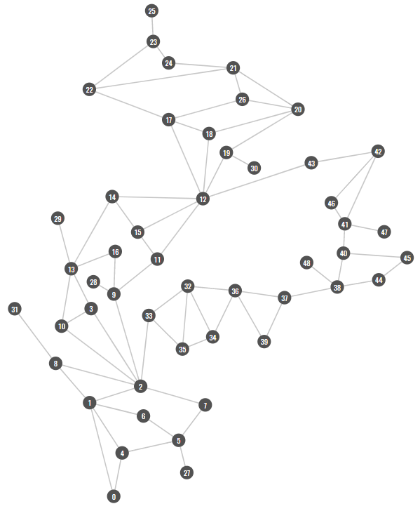
Find the repeated element
Brute Force
Consider all the possibilities, one-by-one.
Also known as exhaustive search.
This is the most general algorithm design pattern, but it can also be the least time efficient.
Find the shortest path from 0 to 25

Slide 3
Brute Force
In this example, we consider all the possible paths from the start to the end node, using, for example, DFS or BFS.
Find the shortest path from 0 to 25

Slide 4
Brute Force
In this example, we can perform a nested loop looking for the repeated element.
for m ← 0 to len(list):
for n ← m + 1 to len(list):
if list[m] = list[n] then
print list[m]
end if
end for
end for
This is exhaustive because we are looking through every possible pair of values.
Find the repeated element

Slide 5
Heuristic Search with Back-Tracking
Applies a greedy, or best-first, search which applies a heuristic (rule of thumb) when a decision is required.
If no solution is found (e.g. a dead-end is reached), back-track to find the last recorded decision point and make an alternative choice.
This can be much more efficient than a brute-force approach. However, the solution found may not be optimal.
In this problem, an example of a heuristic could be: follow the edge whose spatial direction is closest to the direction between the current node and the exit node.
Find the shortest path from 0 to 25

Slide 6
Heuristic Search with Back-Tracking
At the very first node, if we apply this heuristic, we would follow the green edge.
However, following the red edge instead would have produced a shorter path.
Find the shortest path from 0 to 25

Slide 7
Heuristic Search with Back-Tracking
At node 38, following the heuristic would lead to no solution (a dead end).
At this point, we would backtrack to node 38 and follow the red path to continue.
Find the shortest path from 0 to 25

Slide 8
Find the repeated element
Transform-and-Conquer
In this approach we look for ways to:
Convert the problem into a different and more efficiently solved problem
Model the problem differently so that it can solved using alternative algorithms

Slide 9
Find the repeated element
Transform-and-Conquer
In this example, we can pre-sort the list and then look for adjacent elements having the same value.
We have ‘transformed’ the original problem from looking for any repeated elements, into a more specific (and easier to solve) problem looking of looking for repeated adjacent elements.
The ‘transformation’ is enabled via the pre-sorting step.

Slide 10
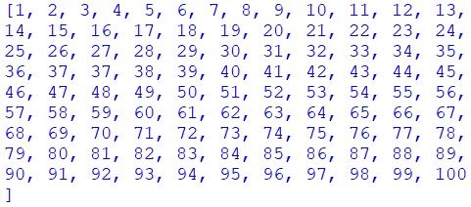
Find the repeated element
Transform-and-Conquer
In this example, we can pre-sort the list and then look for adjacent elements having the same value.
We have ‘transformed’ the original problem from looking for any repeated elements, into a more specific (and easier to solve) problem looking of looking for repeated adjacent elements.
The ‘transformation’ is enabled via the pre-sorting step.
Sort….

Slide 11
Divide-and-Conquer
In this approach, we break the problem down into smaller sub-problems and solve these separately.
The aim is that when these sub-problems are solved and their solutions aggregated, the total computation cost incurred is less that solving the original problem in its entirety.
Find the shortest path from 0 to 25

Slide 12
Divide-and-Conquer
In this example, we can split the graph up into sub-graphs and solve the shortest path problem for each of the sub-graphs.
We note that all paths between nodes 0 and node 25 will pass through nodes 12 and node 2. We can then split the original graph into 3 sub-graphs.
Hence instead of finding the shortest path between 0 and 25 in one go, we can first find the shortest path between 0 and 2, and then between 2 and 12, and then finally between 12 and 25.
Finding the solution to these three shortest path problems and summing them will be less computationally expensive than considering all paths from 0 to 25.
C
B
A

Slide 13
Divide-and-Conquer
We can also parallelise solving the sub-problems into separate computing units.
For instance, the solution to finding the shortest path between 0 and 2 (in sub-graph A), is independent to finding the shortest path between 2 and 12 (in sub-graph B). We can hence put these on separate threads, processes etc. and have them computed in parallel.
It is only when we need to aggregate all the sub-problems that we need to ‘wait’ for all the solutions to be evaluated.
C
B
A

Slide 14
Does 39 exist in this sorted list?
Decrease-and-Conquer
This approach is similar to divide-and-conquer, but instead of dividing, solving and then later aggregating the solutions to all the sub-problems, the aggregating step is not needed. This means that the problem is iterative reduced at each ‘decrease’ step.

Slide 15
Does 39 exist in this sorted list?
Decrease-and-Conquer
In this example, by performing a binary search on the sorted list, we can reduce the problem space by ½ each iteration.
(ie. There is no need to consider the other ‘half’ again after each iteration of the binary search.)

Slide 16
Does 39 exist in this sorted list?
Decrease-and-Conquer
In this example, by performing a binary search on the sorted list, we can reduce the problem space by ½ each iteration.
(ie. There is no need to consider the other ‘half’ again after each iteration of the binary search.)

Slide 17
Top Down
In this approach we look at the problem as a whole and successively break apart the problem into sub-problems with defined inputs and outputs.
Pros
This allows groups to work on different subproblems in parallel with one another and treats each part a bit like a black box, only caring about the output to ensure that the whole algorithm ends up working.
Cons
Unfortunately, it does make the whole algorithm harder to test and it’s harder to identify redundant code.

Slide 18
Bottom up
In this approach we design small parts of the code and then piece them together (a bit like lego blocks)
Pros
Can start writing code quickly and can test regularly. It also is more likely to lead to reusable code and reduce redundancies.
Cons
Can lose track of overall goal and code can become tangled and difficult to follow and as such it can be difficult to identify components that are broken or are not working correctly.

Slide 19

So which should you use?
Ideally, you should probably use a mixture of the two to get best results. There is no definitive way that is ‘best’. Large projects usually benefit from a top down design initially to help break down the problem and manage aspects. Then, for each sub-problem, a bottom up design can often allow for a quick and well tested algorithm to develop.

Slide 20
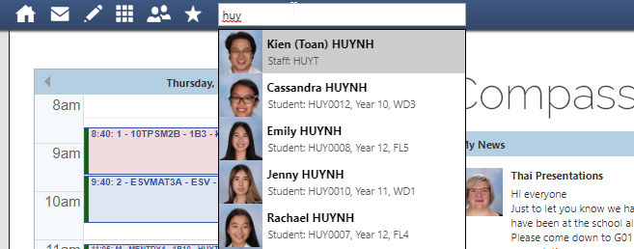
Transform and Conquer

Slide 21
Transform and Conquer
A search problem

Slide 22
Transform and Conquer
my_numbers = [10, 34, 1, 0, -4, 8, 3, 13]
def linear_search(x):
for num in my_numbers:
if num == x:
return True
return False

Slide 23
Transform and Conquer
my_numbers = [10, 34, 1, 0, -4, 8, 3, 13]
def linear_search(x):
for num in my_numbers:
if num == x:
return True
return False
O(n)

Slide 24
Transform and Conquer
my_numbers = [-4, 0, 1, 3, 8, 10, 13, 34]
def binary_search(x, the_list):
if len(the_list) == 1:
return the_list[0] == x
mid = len(the_list) // 2
if x < the_list[mid]:
return binary_search(x, the_list[0:mid])
else:
return binary_search(x, the_list[mid:])

Slide 25
Transform and Conquer
my_numbers = [-4, 0, 1, 3, 8, 10, 13, 34]
def binary_search(x, the_list):
if len(the_list) == 1:
return the_list[0] == x
mid = len(the_list) // 2
if x < the_list[mid]:
return binary_search(x, the_list[0:mid])
else:
return binary_search(x, the_list[mid:])
O(logn)

Slide 26
Transform and Conquer
my_numbers = [-4, 0, 1, 3, 8, 10, 13, 34]
def binary_search(x, the_list):
if len(the_list) == 1:
return the_list[0] == x
mid = len(the_list) // 2
if x < the_list[mid]:
return binary_search(x, the_list[0:mid])
else:
return binary_search(x, the_list[mid:])
O(logn)
<
O(n)

Slide 27
Transform and Conquer
my_numbers = [-4, 0, 1, 3, 8, 10, 13, 34]
def binary_search(x, the_list):
if len(the_list) == 1:
return the_list[0] == x
mid = len(the_list) // 2
if x < the_list[mid]:
return binary_search(x, the_list[0:mid])
else:
return binary_search(x, the_list[mid:])
But you need to sort first!

Slide 28
Transform and Conquer
my_numbers = [-4, 0, 1, 3, 8, 10, 13, 34]
def binary_search(x, the_list):
if len(the_list) == 1:
return the_list[0] == x
mid = len(the_list) // 2
if x < the_list[mid]:
return binary_search(x, the_list[0:mid])
else:
return binary_search(x, the_list[mid:])
But you need to sort first!

Slide 29
Transform and Conquer
my_numbers = [-4, 0, 1, 3, 8, 10, 13, 34]
def binary_search(x, the_list):
if len(the_list) == 1:
return the_list[0] == x
mid = len(the_list) // 2
if x < the_list[mid]:
return binary_search(x, the_list[0:mid])
else:
return binary_search(x, the_list[mid:])

Slide 30
Transform and Conquer
my_numbers = [-4, 0, 1, 3, 8, 10, 13, 34]
def binary_search(x, the_list):
if len(the_list) == 1:
return the_list[0] == x
mid = len(the_list) // 2
if x < the_list[mid]:
return binary_search(x, the_list[0:mid])
else:
return binary_search(x, the_list[mid:])

Slide 31
Transform and Conquer!
my_numbers = [-4, 0, 1, 3, 8, 10, 13, 34]
def binary_search(x, the_list):
if len(the_list) == 1:
return the_list[0] == x
mid = len(the_list) // 2
if x < the_list[mid]:
return binary_search(x, the_list[0:mid])
else:
return binary_search(x, the_list[mid:])

Slide 32
Transform and Conquer
╳ |  | ╳
╳ | ╳
Have i won?

Slide 33

The Supervisor’s Problem
The supervisors problem asks if it is possible to ‘supervise’ all roads in a network with ‘n’ supervisors.
A supervisor can only stand on a junction of multiple roads and can supervise all roads that are connected to the junction that they are standing on.

Slide 34
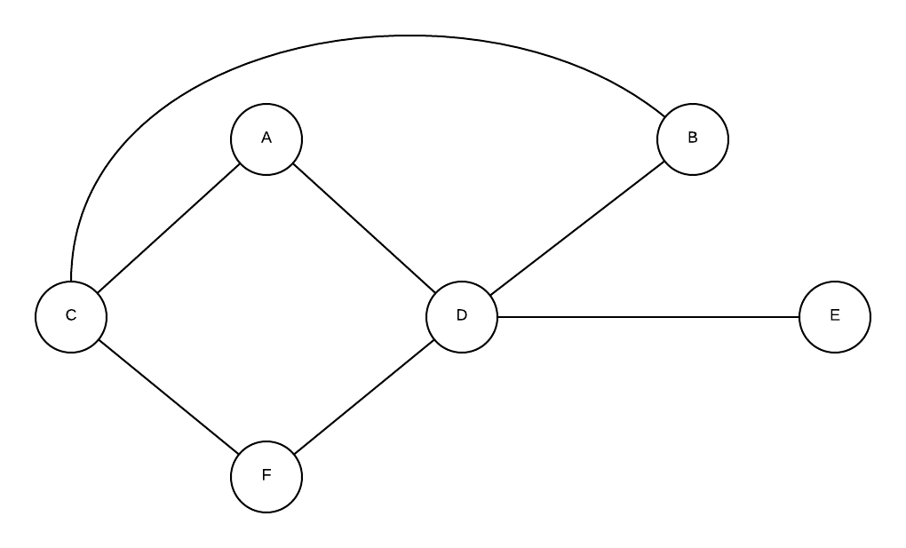
The Supervisor’s Problem

Slide 35
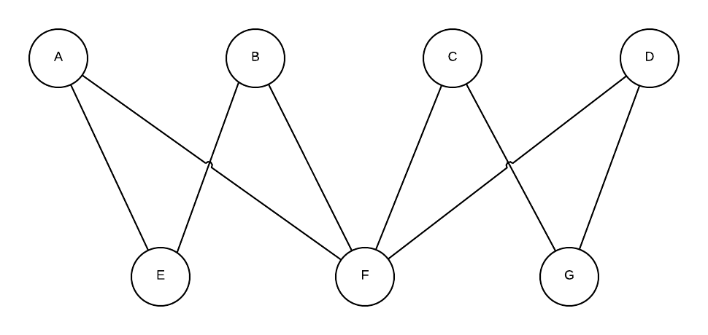
The Supervisor’s Problem

Slide 36
The Supervisors problem
We can do these problems through trial and error (brute force) but they become very difficult as our problems get larger… if only we could transform them into something that was easier to conquer.
Transform and conquer
Transform and conquer is an approach that you can use when it is difficult to solve a particular problem in its current state or form but it can be converted into another form that is easier to deal with.

Slide 37
A simultaneous equation solution
We can solve this by converting it into a series of simultaneous equations…

Slide 38
Have a go yourself

